Slide 1
INFINET DEVICES OFFLINE ANALYSIS
Analysis by:
Quentin Odongo

Slide 2
Issue Definition
What We Know
Analyze

Slide 3
Issue Definition
The 4 android boxes running the Infinet POC have been intermittently going offline, as shown on AirDroid and KOKO Core
Remote control of the devices was affected, as well as the WiFi hotspot provided by the device to Infinet customers
Objective is to determine the root causes of the devices going offline and finding the best solution to employ to solve the issue

Slide 4
What We Know
Data collected on the 4 devices revealed the following:
‘internet_connectity_available=false’ error: Internet connection was lost in the offline duration
‘ip_address=No IP Address’ error: Devices’ IP addresses would not be detected sometimes
Internet connectivity was restored only when the device’s IP address was not detected by the Radio Monitor app (which sends heartbeats to the server), which triggers the restarting of the network port of the device, thus detecting the IP address and re-establishing internet connection
Device installed in Perfect Gas KP displayed an authorization token expiry error (error related to OTP generation on server)
Radio Monitor app was outdated on the 4 devices (version 1.0 or 1.0.1; latest version is 1.0.2)
More details available in the following sheet

Slide 5
What We Know: Cont’d
After manually updating the Radio Monitor app on the devices to the latest version the following was observed:
The ‘internet_connectivity_available=false’ and ‘ip_address=No IP address’ errors both trigger a restart to the devices’ network ports, re-establishing internet connectivity and detecting their IP addresses
The devices currently regain online status within ~10 seconds of losing connectivity

Slide 6

Analyze
Identify possible root causes
Analyze the root causes

Slide 7
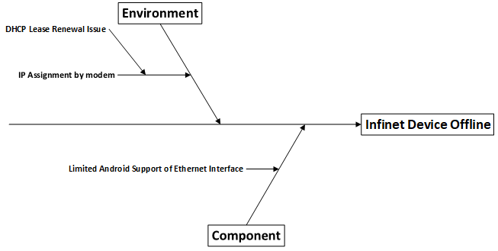
Cause and Effect Diagram

Slide 8
Possible Root Causes
Limited Android Support of Ethernet Interface: Research shows that most android devices that support internet connection through Ethernet have issues dropping connection, thus it could be a firmware issue with the android boxes
DHCP Lease Renewal Issue: The modem may be handling DHCP lease renewal poorly (renewal of the use of an IP address by the android box) when it or the android box restarts

Slide 9
Analyze Possible Root Causes: Dhcp Lease Assignment
Modem settings on DHCP leases were adjusted for this test with the following observations made:
With lease renewal originally set to occur every 12 hours (default setting), changing the renewal to occur every 1 hour increased connectivity interruptions to every hour as well, specifically at the time of the lease renewal
Setting a static IP (within the range of IPs that are assigned by DHCP server) for the android box failed to resolve the issue, as internet connectivity was still being interrupted every hour
Setting a static IP (outside the range of IPs that are assigned by DHCP server) for the android box also failed to resolve the issue, with the same results being exhibited
Increasing lease time to 9999 hours (~416 days) significantly reduced internet connectivity interruptions

Slide 10
Recommendations
Increase DHCP lease time for the devices to a much longer amount of time (e.g. 9999 hours) to reduce the connectivity interruptions
Develop a mechanism for automatically updating the Radio Monitor app, along with other apps on the android box that require regular updates, i.e. AirDroid Biz Daemon, Ryarc CM Player and AFWall+

